Slide 1

Apriori Algorithm: Unveiling Association Rules in Data Mining
Explore how the Apriori algorithm finds hidden associations within data.
Used in markets, recommendations, and medical diagnostics for pattern discovery. Qasim Kharodia TY IT 19 DMBI IA Video

Slide 2

Core Concepts: Frequent Itemsets and Support
Frequent Itemsets
Support
Groups of items often bought together in transactions.
Percentage of transactions containing the itemset.
Minimum Support
User-defined filter to identify meaningful itemsets.

Slide 3
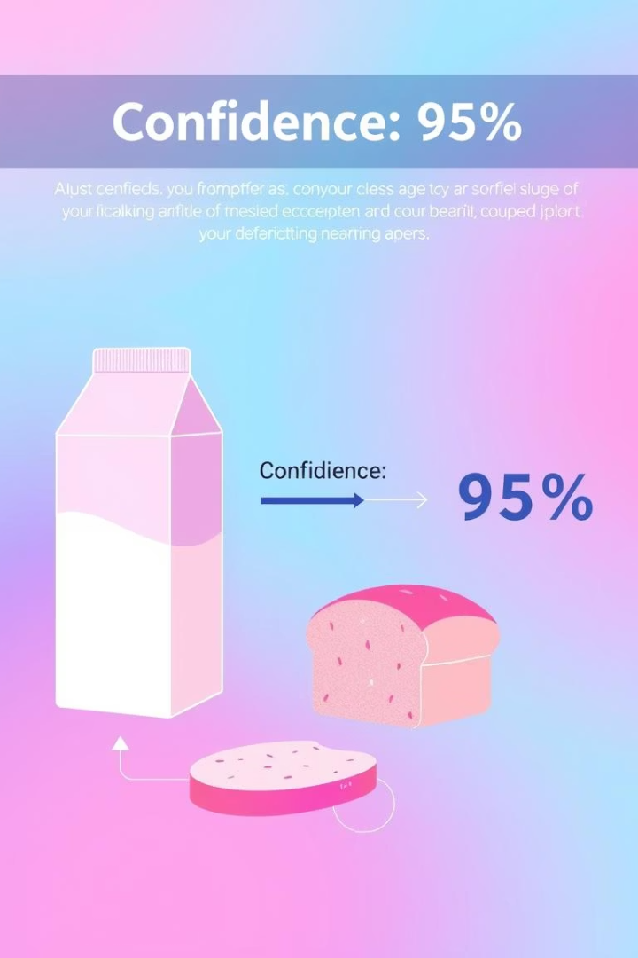
Confidence and Association Rules
Association Rule
Confidence
Expresses a predictive if-then relationship between items.
Reliability measure of the association rule.
Example
70% who buy milk also buy bread.

Slide 4
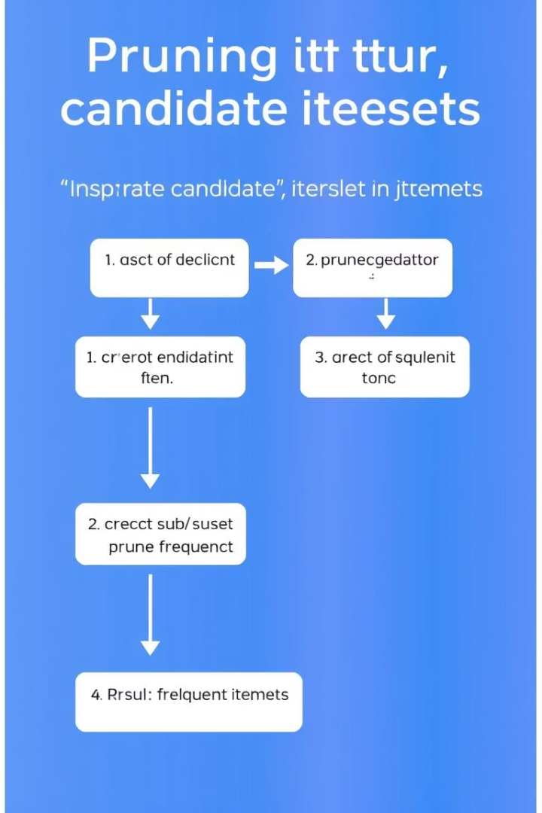
Apriori Principle: A Key Optimization Strategy
Apriori Property
Subsets of frequent itemsets must themselves be frequent.
Candidate Generation
Creates itemsets of increasing size iteratively.
Pruning
Removes itemsets with infrequent subsets to reduce load.

Slide 5
Example: Market Basket Analysis
Dataset
Results
Customer transactions with common grocery items
Frequent Itemsets: Bread, Milk, Eggs, Bread & Milk, Milk & Eggs
Bread, Milk, Eggs, Butter, Cheese
Rules: Bread -> Milk (65% confidence)
Minimum Support: 30%
Milk -> Eggs (70% confidence)
Minimum Confidence: 60%

Slide 6
Strengths and Limitations of Apriori
Strengths
Limitations
Simple and well-known algorithm
Computationally expensive on big data
Finds all rules above thresholds
High memory use for candidate itemsets
Struggles with rare item associations

Slide 7





Conclusion and Future Research
Fundamental Tool
Key algorithm for mining association rules.
Scalability
Developing scalable versions for big data challenges.
Hybrid Methods
Combining Apriori with FP-Growth and advanced techniques.
New Applications
Expanding use in social networks and bioinformatics.

